Slide 1
Market Place DBMS
Group 19: Chi Nguyen, Saurabh Tomar, Changho Lee

Slide 2
Target Application
Online market place database
Register users who want to use the market place
Allowing users to view/buy products
Allowing sellers to list products

Slide 3
End users
Shoppers
Browse
Add items to shopping cart
Purchase items
Leave seller/item reviews
Private Seller/Business
Post items to sell
Fill in product description
Update inventory
Fill orders
Administrator
Moderate users
View registered users information
Track and view all reviews

Slide 4
Entities
USER
USER INFO
ADDRESS
SHOPPING CART
PRODUCT
DEPARTMENT
PRODUCT/SELLER REVIEWS
ORDERS

Slide 5
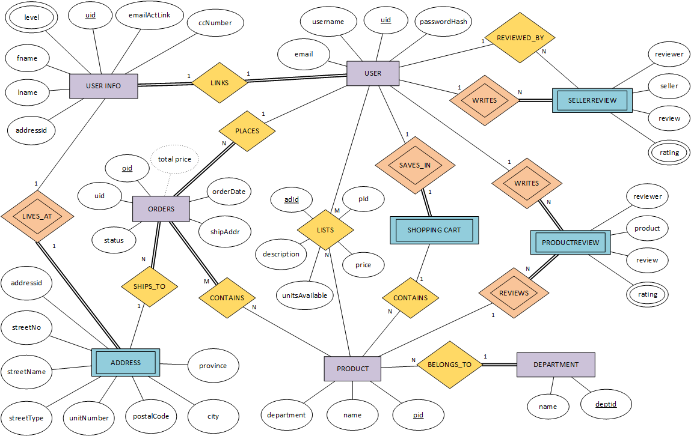
ER DIAGRAM

Slide 6
Questions?

